Slide 1
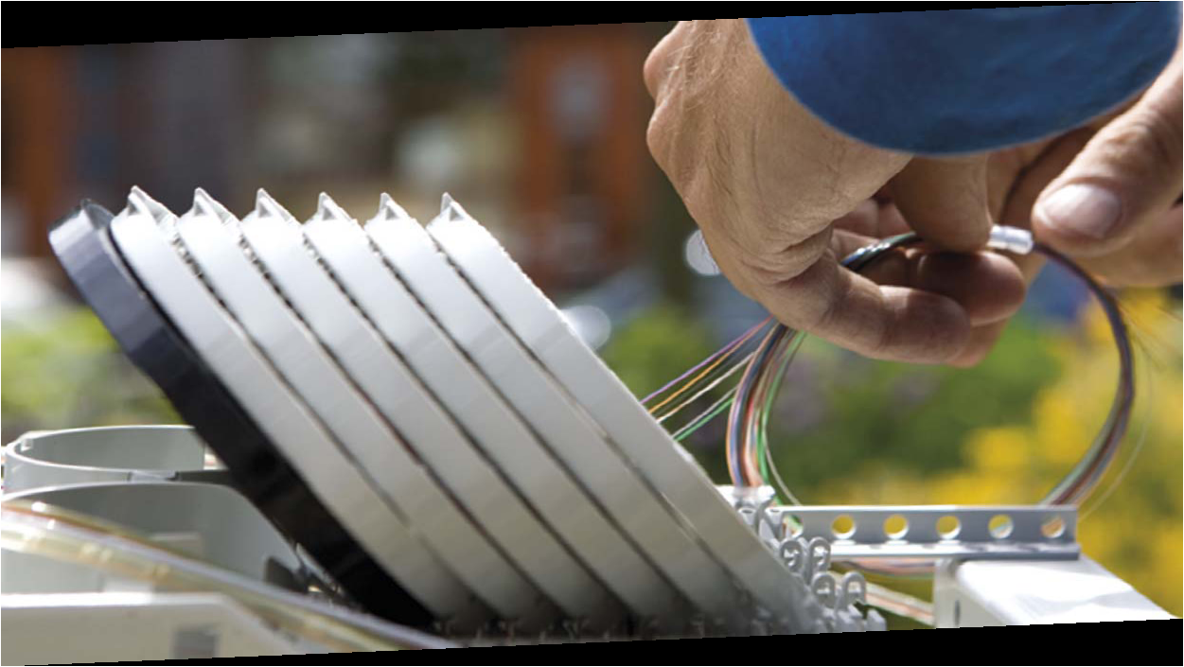
Cortesia Prysmian Group

